Slide 1

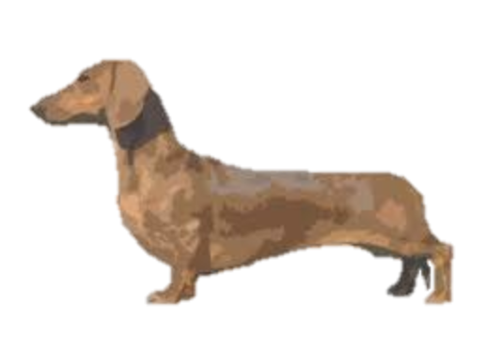

Wireframe
Kitty Graphic
Kitty Graphic
Kitty Graphic
Kitty Graphic
Kitty Graphic
Kitty Graphic
Kitty Graphic
Kitty Graphic
Kitty Graphic
Kitty Graphic
Kitty Graphic
Kitty Graphic
Kitty Graphic
Kitty Graphic
Kitty Graphic
Kitty Graphic
Kitty Graphic
Kitty Graphic
Kitty Graphic
Kitty Graphic
480px
Kitties move down every x seconds
Don’t let the kitties reach the fence!
720px
Notes:
Add background
Add game background
Add daschund paddle
Add landing page
Add kitty graphics
Bonus: add levels

Slide 2

Wireframe
480px
Kitties move down every x seconds
Don’t let the kitties reach the fence!
720px
Notes:
Add background
Add game background
Add daschund paddle
Add landing page
Add kitty graphics
Bonus: add levels

Slide 3
Flow Chart
Welcome Page
Instructions
Click Play
Win
Lose
Round 1
Win
Lose
Round 2
Win
Lose
Round 3
Win
Lose
Winner Page

Slide 4


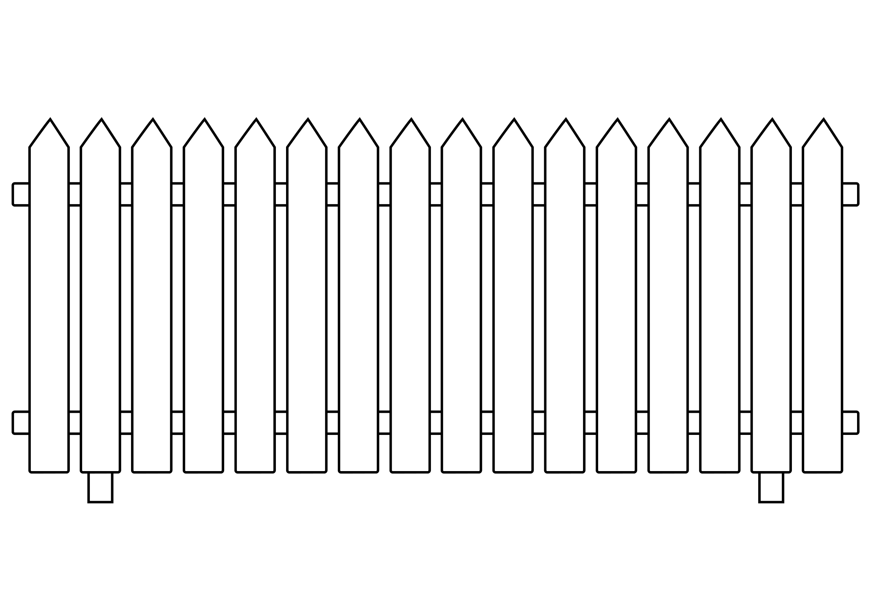

Slide 5
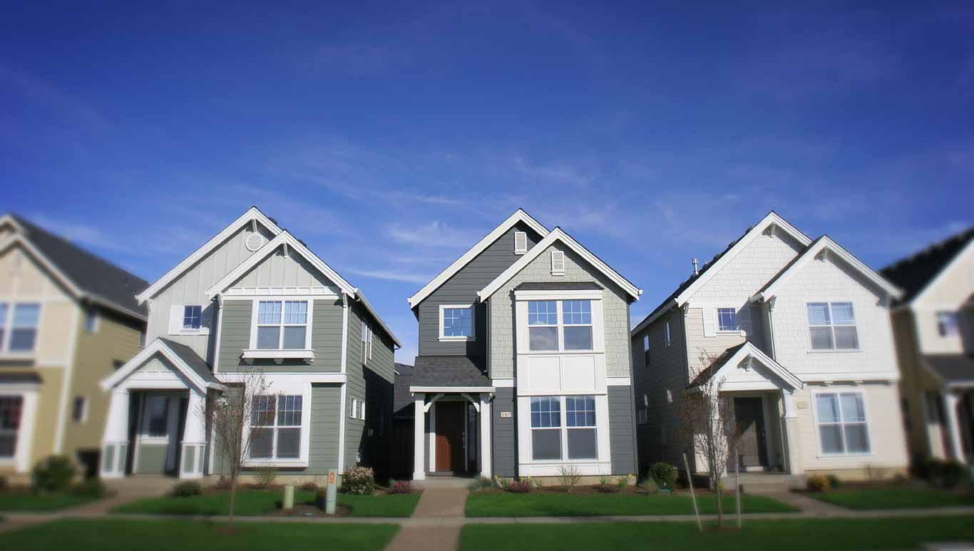

Slide 6




